Slide 1

Customer Shopping Behavior Analysis
Uncovering insights from 3,900 transactions across product categories to guide strategic business decisions.

Slide 2
Dataset at a Glance
3,900
18
37
Purchases
Features
Missing Ratings
Key Data Dimensions
Demographics: Age, Gender, Location, Subscription
Purchase: Item, Category, Amount, Season, Size
Behavior: Discounts, Frequency, Rating, Shipping

Slide 3

Data Preparation in Python
01
Load & Explore
Imported with pandas; used df.info() and .describe()
02
Clean & Impute
Filled missing Review Ratings with category median
03
Feature Engineering
Created age_group and purchase_frequency_days columns
04
Load to PostgreSQL
Cleaned DataFrame pushed to database for SQL analysis

Slide 4
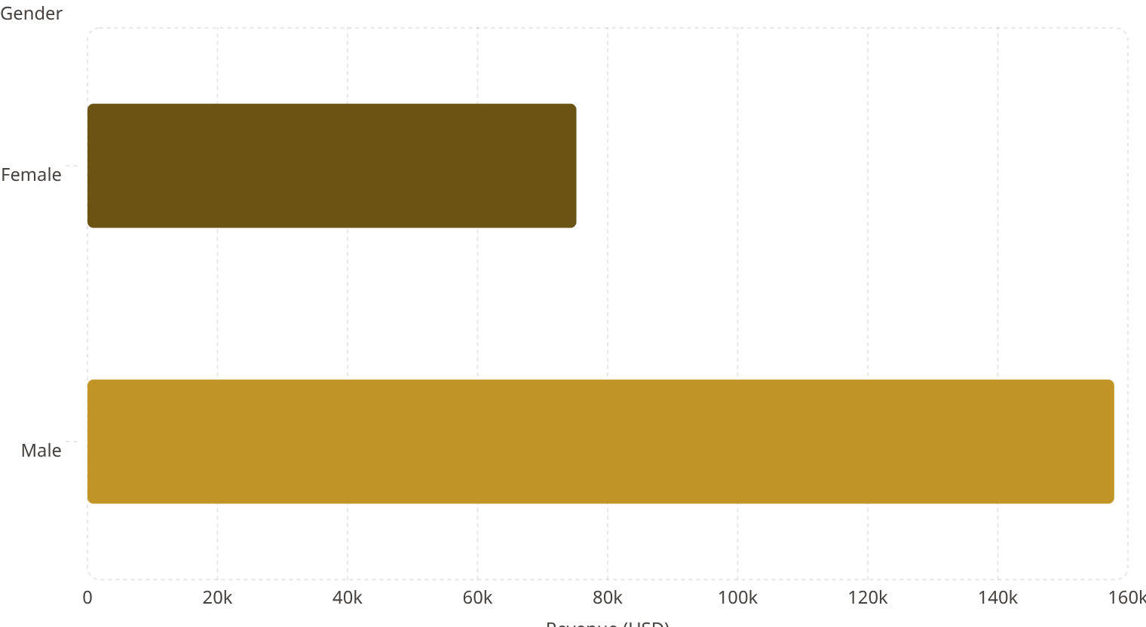
SQL Analysis: Revenue & Spending
High-Spending Discount Users
839 customers used discounts yet spent above the average purchase amount.
Shipping Type vs. Spend
Standard: $58.46 avg
Express: $60.48 avg

Slide 5
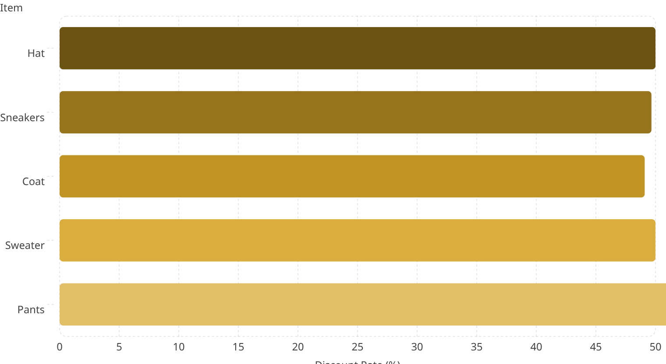
Top-Rated Products & Discount Dependency
Top 5 by Avg Rating
Most Discount-Dependent Products
Gloves
Sandals
3.86 ⭐
3.84 ⭐
Boots
Hat
3.82 ⭐
3.80 ⭐
Skirt
3.78 ⭐

Slide 6


Customer Segmentation
Repeat Buyers & Subscriptions
Customers with >5 purchases:
Non-subscribers: 2,518
Subscribers: 958
Loyal·79.9%
·79.9%
·
Returning·17.97%
·17.97%
·
New·2.13%
·2.13%
·
Loyal customers dominate — 80% of the base.

Slide 7
Subscribers vs. Non-Subscribers
Subscribers
Non-Subscribers
1,053 customers
2,847 customers
Avg Spend: $59.49
Avg Spend: $59.87
Revenue: $62,645
Revenue: $170,436
Similar avg spend — but non-subscribers drive 73% of total revenue due to volume.

Slide 8
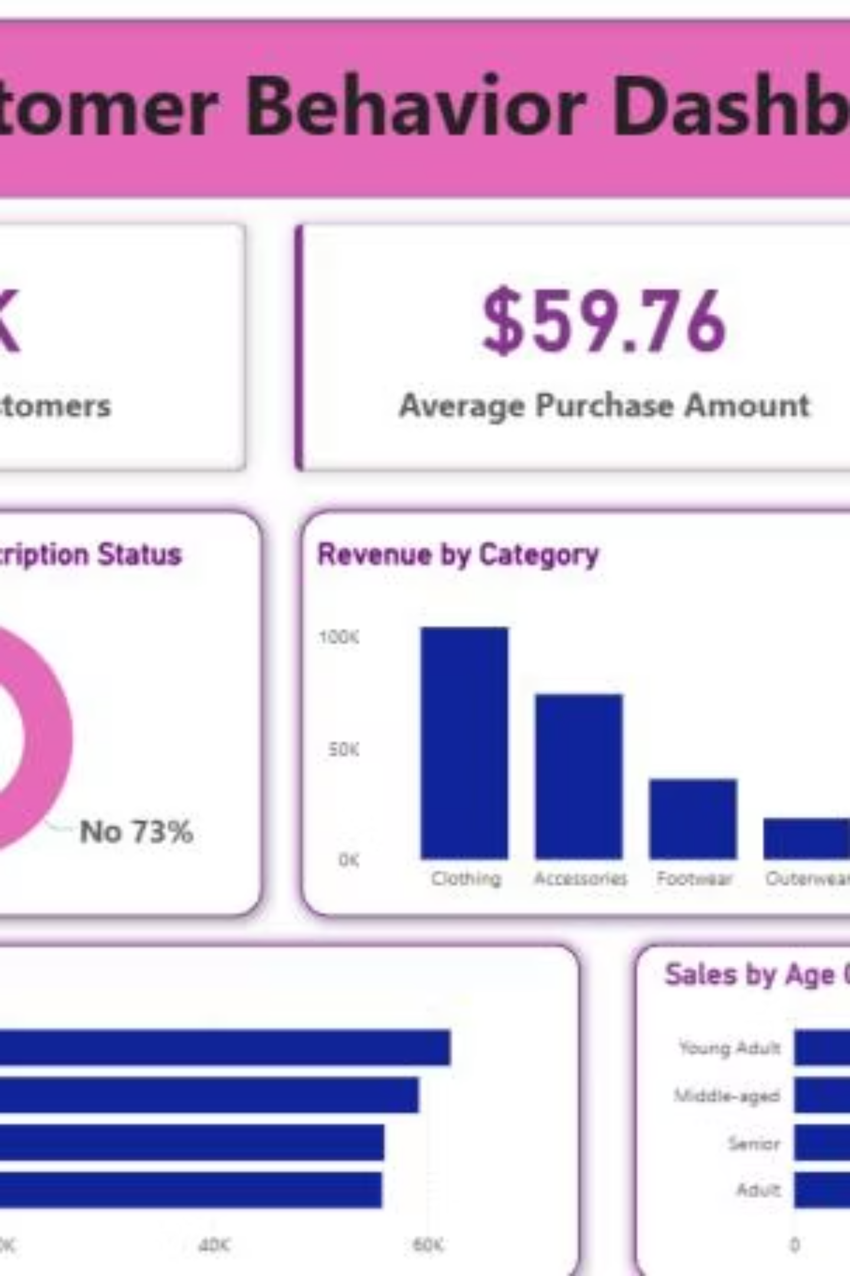
Revenue & Sales by Category and Age

Slide 9
Top Products by Category
Category
#1
#2
#3
Accessories
Jewelry (171)
Sunglasses (161)
Belt (161)
Clothing
Blouse (171)
Pants (171)
Shirt (169)
Footwear
Sandals (160)
Shoes (150)
Sneakers (145)
Outerwear
Jacket (163)
Coat (161)
—

Slide 10


Business Recommendations
Boost Subscriptions
Promote exclusive subscriber benefits
Loyalty Programs
Reward repeat buyers to grow the Loyal segment
Review Discount Policy
Balance sales boosts with margin control
Targeted Marketing
Focus on high-revenue age groups & express-shipping users

